Slide 1
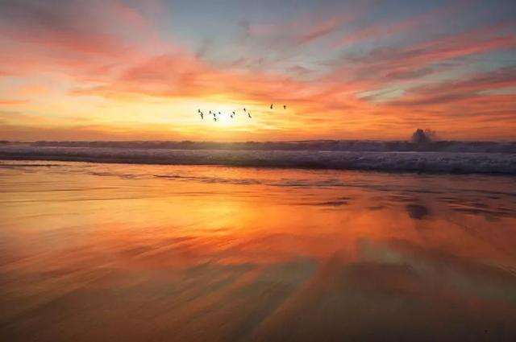
Unit 2
Making a difference

Slide 2


Slide 3


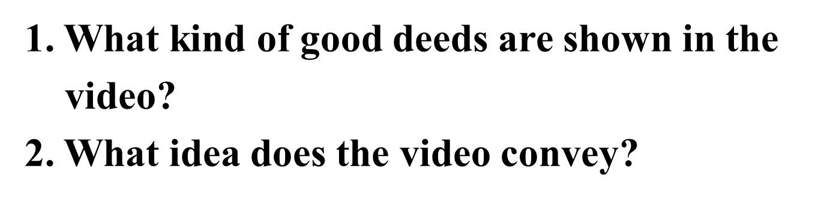
Activity 1
Watch the video and answer questions.

Slide 4
Always Ready to Help
On 5 September 2016, China celebrated its first Charity Day with a series of activities around the country. A charity fair was held in Beijing, where charity organizations shared information and resources.
Caring about others and being ready to help are traditional Chinese moral virtues. Setting aside a special day once a year helps to further promote these values. People are encouraged to give a helping hand whenever possible. This is even more important than donating money.

Slide 5
In the West, there are similar days to encourage people to do good deeds. Pay It Forward Day is a day when people do one or two good deeds, such as visiting an elderly neighbour and asking if they need anything, or letting a restaurant manager know just how great their waiter or waitress was. Instead of asking for something in return, people pass on Pay It Forward cards . These cards are a way of asking the recipients to also do good deeds and then pass the cards on to other people.

Slide 6
Both Pay It Forward Day and Charity Day in China remind us of the power of giving. And doing good deeds is actually quite easy. There are opportunities to do good deeds every day, and most good deeds don't need a lot of time or preparation .Just look around you to get started: help a classmate with their studies; ask someone who looks lost if they need directions; or just offer to help out with something in the home.
Remember—just one small act can make a big difference.

Slide 7

Look at the pictures of the three people and read the quotations. Talk about the following points.
the contribution these people made to
society
the qualities you admire in each of them
other people who have similar qualities

Slide 8
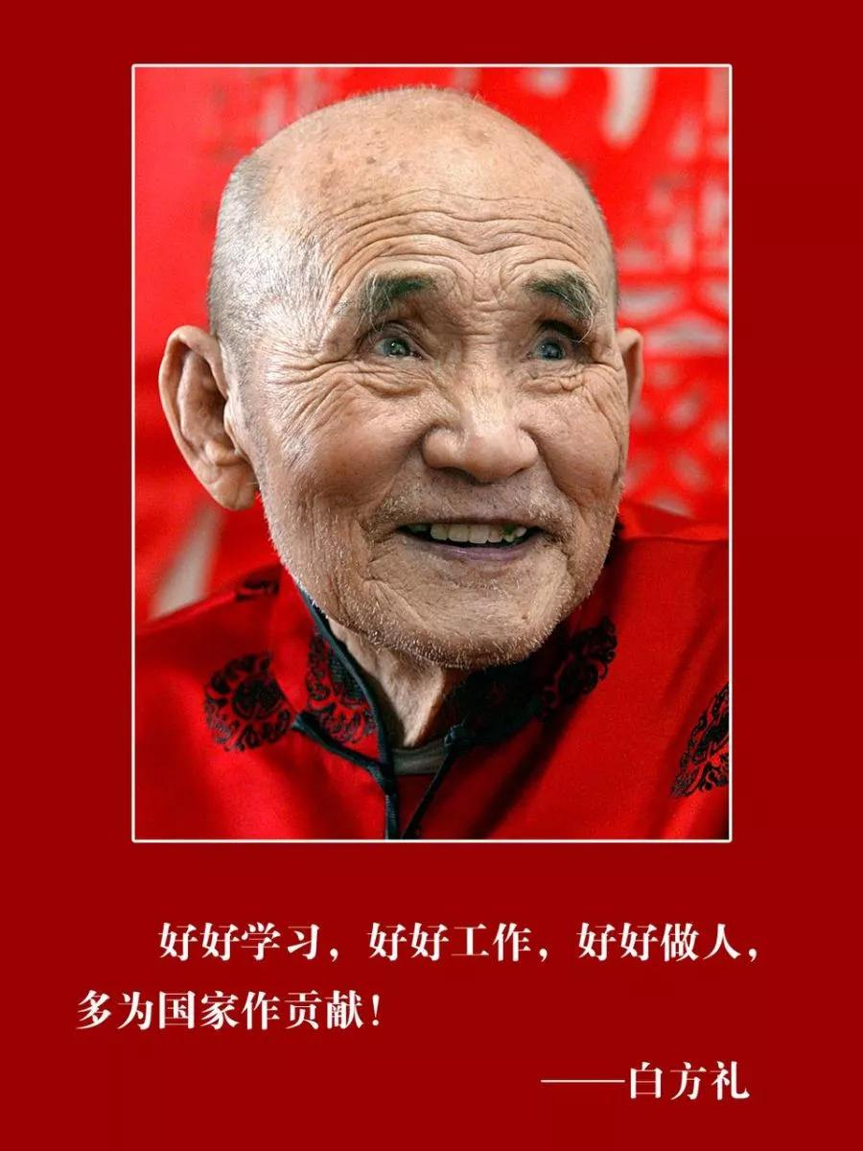
Bai Fangli(1913-2005)was a retired worker in Tianjin. He started riding tricycles to make money when he was 74, and donated his income to poor students. In eighteen years, he donated 350,000 yuan in total, helping more than 300 students complete their studies. In 2012, he was awarded a special honour for "Touching China".

Slide 9
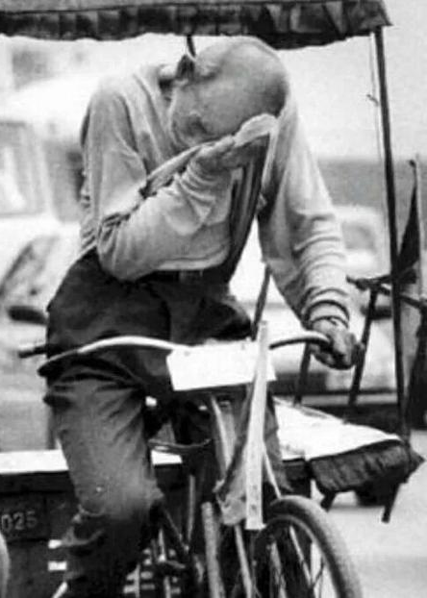
I’m old. All I can do is ride a tricycle and make money for the students…Knowing that the kids now have money for school is what keeps me going and gives me more energy.
Bai Fangli
tricycle driver

Slide 10
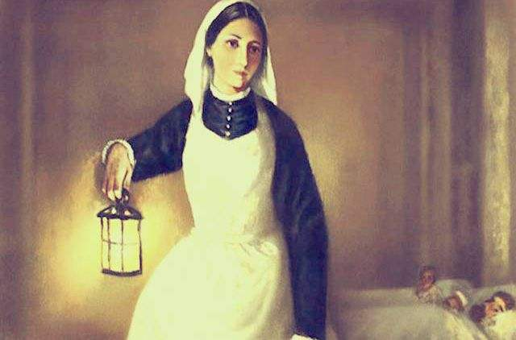
Florence Nightingale (1820-
1910) was an English social reformer and statistician, and the founder of modern nursing. During the Crimean War, she worked to improve hospital conditions. The death rate declined greatly because of her efforts. She was known for her night rounds to aid the wounded, establishing her image as the“Lady with the Lamp”.

Slide 11
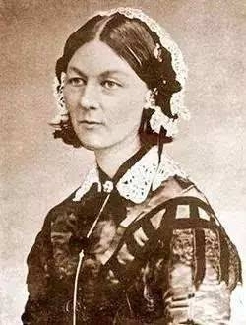
The amount of relief and comfort experienced by the sick after the skin has been carefully washed and dried, is one of the commonest observations made at a sick bed.
Florence Nightingale

Slide 12
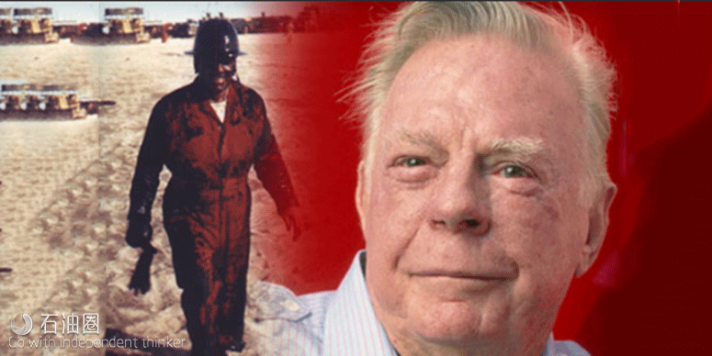
Red Adair (1915-2004) was an American oil-well firefighter. During his career, he and his company put out lots of fires internationally, including the explosion of the Piper Alpha oil rig in the North Sea and the oil-well fires in Kuwait.

Slide 13
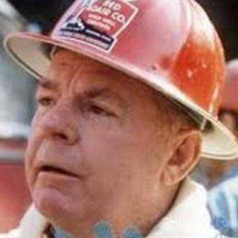
It scares you: all the noises, the rattling, the shaking. But the look on everybody’s face when you are finished and packing, it’s the best smile in the world; and there’s nobody hurt, and the well’s under control.
Red Adair
oil well firefighter

Slide 14

Talk about a person’s personal qualities with examples.

Slide 15
personal qualities; moral virtues
selfless
wise
determined
generous
humorous
devoted
capable/competent
hardworking/diligent
aggressive/ambitious
creative
friendly
warm/kind-hearted
easygoing
helpful
honest
sympathetic

Slide 16

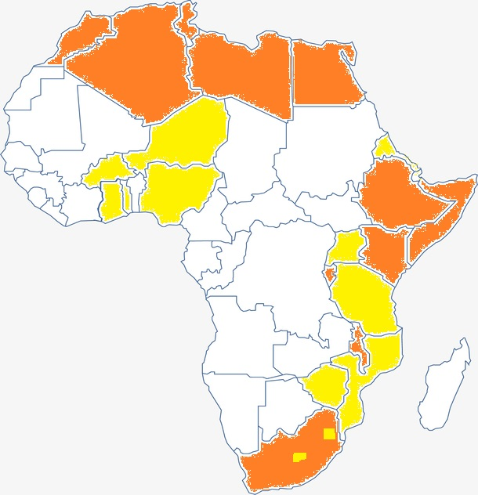
Look at the map and talk about water problems in Africa.
Freshwater problems
in Africa by 2025
Freshwater shortage
Freshwater stress

Slide 17
Pre-reading: Background Information
Water shortage in Africa
Water shortage remains a serious issue in parts of Africa for years, especially in North Africa. In Africa, millions of people can’t get access to clean drinking water, and they are living in areas with poor sanitation [ˌsænɪˈteɪʃn] services.(卫生系统）

Slide 18
Pre-reading: Background Information
The reasons for water shortage in Africa are complicated.
Frequent droughts due to global warming and deforestation have shrunk lakes and changed rainfall patterns.
Traditional irrigation technology and agriculture have caused a good sum of water waste.
Growing population and urbanization have increased the domestic and industrial water consumption, which can’t be fully supported by poor infrastructure [ˈɪnfrəstrʌktʃə(r)].（基础设施）

Slide 19

Video time
This 13-year-old African girl has to spend 8 hours a day to fetch water. What’ s worse, this is the normal life for the people around her.
What should we do
to solve the problem?

Slide 20
Tick the solutions that you think are most effective to supply Africa with fresh water.
collect and purify rainwater
fund (provide money for sth) water projects
build wells and pumps
recycle (use sth again) waste water
set up facilities to purify water
develop new water conservation (protection) technologies

Slide 21
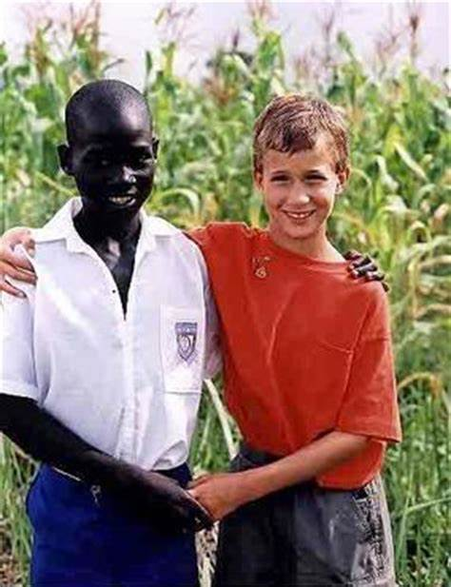
Fast reading
Read the passage and find out what Ryan did to help solve the problem of water shortage in Africa.
Ryan raised $2,000 to build a well near a primary school in Uganda, and later set up a foundation to attract more support to provide clean, safe water for people in Africa.

Slide 22
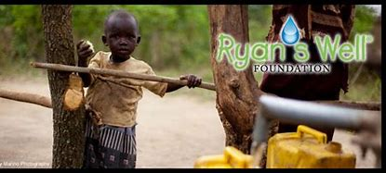
Fast reading
Choose the best explanation of the title and give your reasons.
1. The well built by Ryan solved
the problem of worldwide water
shortage.
2. The more wells you dig, the better
the world will be.
3. The well built by Ryan encouraged
more people to help make the world
a better place.

Slide 23
Read the text carefully and get the line of efforts that Ryan made to help set up wells in Africa.
The passage is arranged in the order of time. We should find out what Ryan did at different periods.
During each period, he met different difficulties. We should find out what the difficulties were.

Slide 24
first heard of water problem in Africa
(know the problem)
earned enough money for a hand pump
(find a solution)
asked others for help to donate money
(solve the problem)
went to Uganda to see the wells
(evaluate the results)
set up a foundation for more help
(raise the theme into a higher lever)

Slide 25
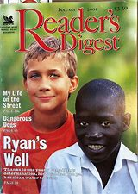
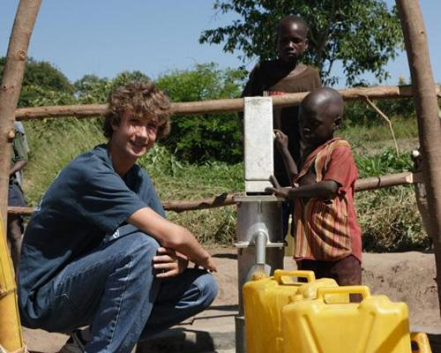
Intensive reading: Find detailed information
Complete Ryan’s story with expressions from the passage.

Slide 26
Intensive reading: Find detailed information
Complete Ryan’s story with expressions from the passage.
1. Ryan could get clean drinking water within ten steps, but
some African children had to ______________________
_________________. So Ryan decided to help.
2. Ryan cleaned windows and did gardening, and reached
___________________. But when he ________________
________ he was told it cost $2,000 to build a well.
walk ten kilometres to
get water every day
his first target of $70
gave the money to
a charity

Slide 27
Intensive reading: Find detailed information
Complete Ryan’s story with expressions from the passage.
3. Ryan persuaded his classmates and neighbours to _______
_______. His mother’s friend also helped him. After
several months, he raised enough money and a well was
built in Uganda.
4. Ryan visited Uganda. He saw ______________ . He also
saw ___________________________who had turned out
to welcome him.
donate
money
the finished well
hundreds of delighted students

Slide 28
Intensive reading: Find detailed information
Complete Ryan’s story with expressions from the passage.
5. Later, Ryan’s experience led him to _________________
to encourage more people to help.
6. Today, the life-changing gift of clean water ___________
__________________________________________.
set up a foundation
has benefited
over 800,000 people in 16 countries across Africa

Slide 29


Post-reading: Think and Share
1. What kind of person do you think Ryan is ?
2.Which of his qualities do you admire most?
Why?
3. As a senior high school student, what
can you do to help people in need?

Slide 30


Do you know some good deeds? Write a passage.

Slide 31


